Slide 1

Emerging Technology Training
for a Seamless Digital Transformation

Slide 2


Slide 3
Job Profile : Technical Analyst (DC- Ops)
Technical Parameters:-
1. Candidates should have Good Knowledge of troubleshooting, maintenance, configuration, backup, server admin, technical support.
2. Handle issues regarding Cisco, Routers, Switches, LAN & WAN & MAN connection, and also deals with Installation, Configuration, Maintenance, and Troubleshooting.
3. Job roles involve support of products on windows Server, UNIX, Mainframe, Share Point, and Active Directory.
4. Good knowledge in Installation of hardware & Software.
5. Work on Client Servers like Windows, Linux, UNIX
6. Work on various Software-Applications
7. Ability to troubleshoot common PC issues (Optional)
8. Antivirus monitoring

Slide 4
Parameter for Communication (English).
1.Candidates should be comfortable in speaking English.
2.Fluent in English communication
Other Conditions.
CTC 1.89L for the first 6 months hence after 2.2 LPA.
Free transport.
BTECH (CS/IT/EC/EE) /MCA/BCA/ candidates with 60% through-out in academics.
Designation Network (Network Analyst-DC-Ops).
Pure Tech/Software profile.
Location NOIDA.
Free Induction Training 30 days
No stipend/Salary during training.
Twice evaluation/test shall be conducted during training; candidates need to clear the
evaluation as per our partners HTD parameters to finally join/on-board the organization.
Kindly revert back with the tentative dates for Campus drive.

Slide 5
Cognixia - a leading emerging technologies training provider
Cognixia | an award-winning training arm of Collabera
Delivered trainings in more than
37 countries
Over 1 | 00 | 000
professionals
trained worldwide
More than 450 clients
across the globe
Over 1300 Trainers
Best-in-class trainings on emerging technologies

Slide 6





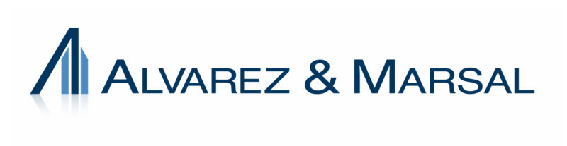



















Our Clients

Slide 7
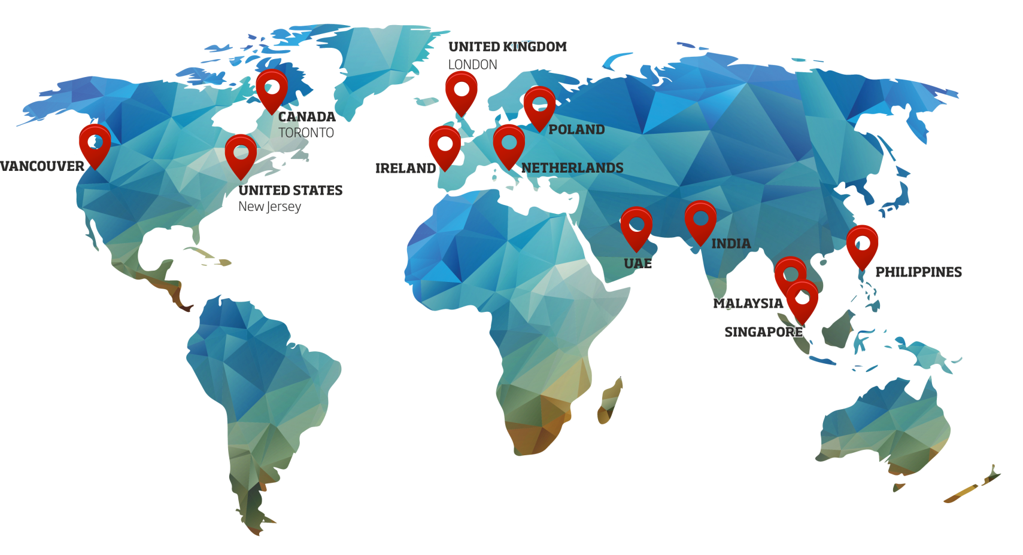
Our Footprint

Slide 8


Slide 9

THANK YOU
For more information or to set up an appointment | kindly contact us today.

